Slide 1
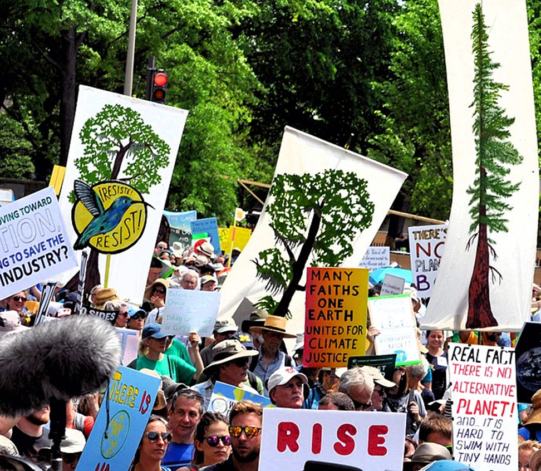

Slide 2
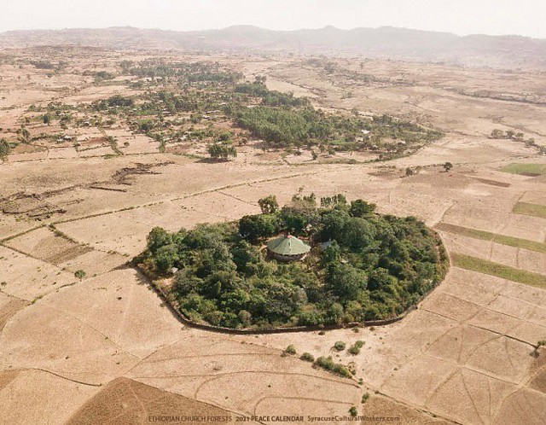
Notes:
Christian
Biodiversity thrives in Ethiopia’s church forests (nature.com)

Slide 3
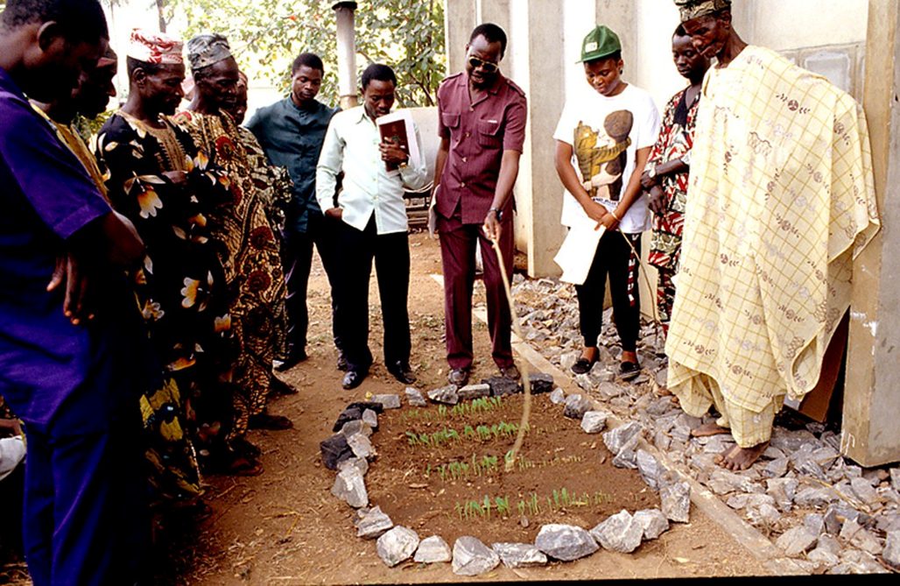
Notes:
Christian farmers learning about sustainable farming methods. Flickr
GREEN ANGLICANS MOVEMENT LAUNCHES IN RWANDA – Green Anglicans

Slide 4
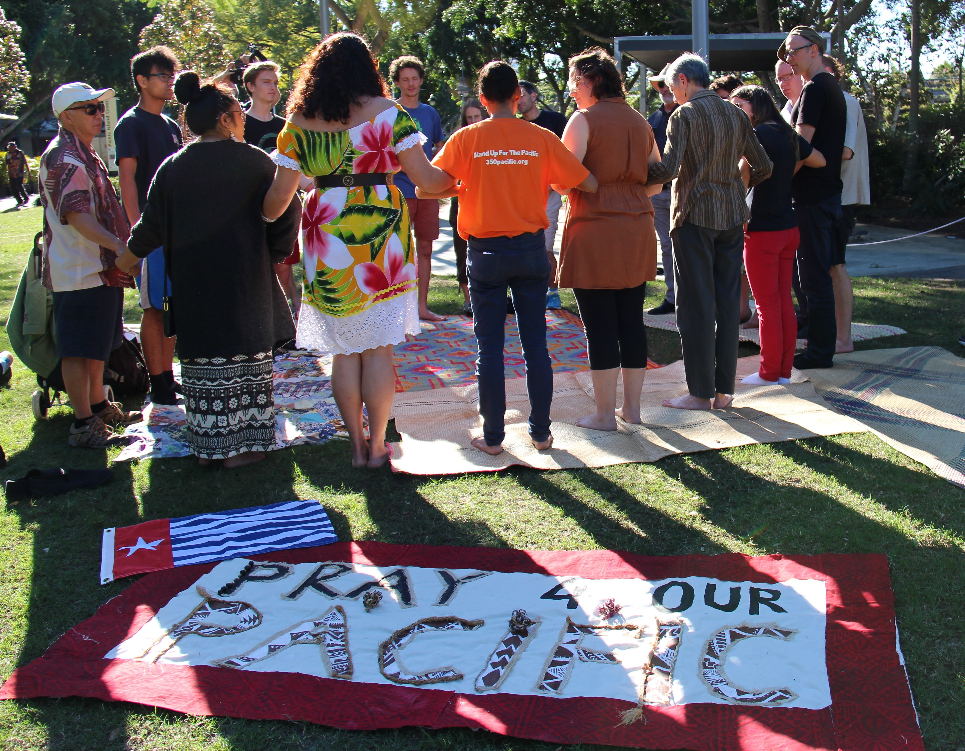
Notes:
https://www.flickr.com/photos/350org/29509037195

Slide 5
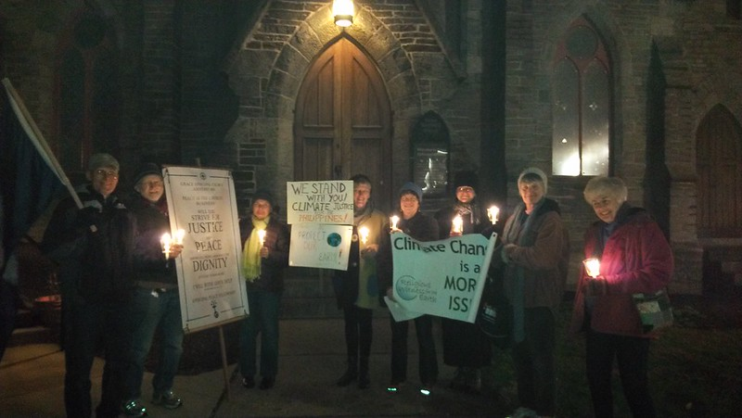
Notes:
https://www.flickr.com/photos/350org/11002155135/

Slide 6
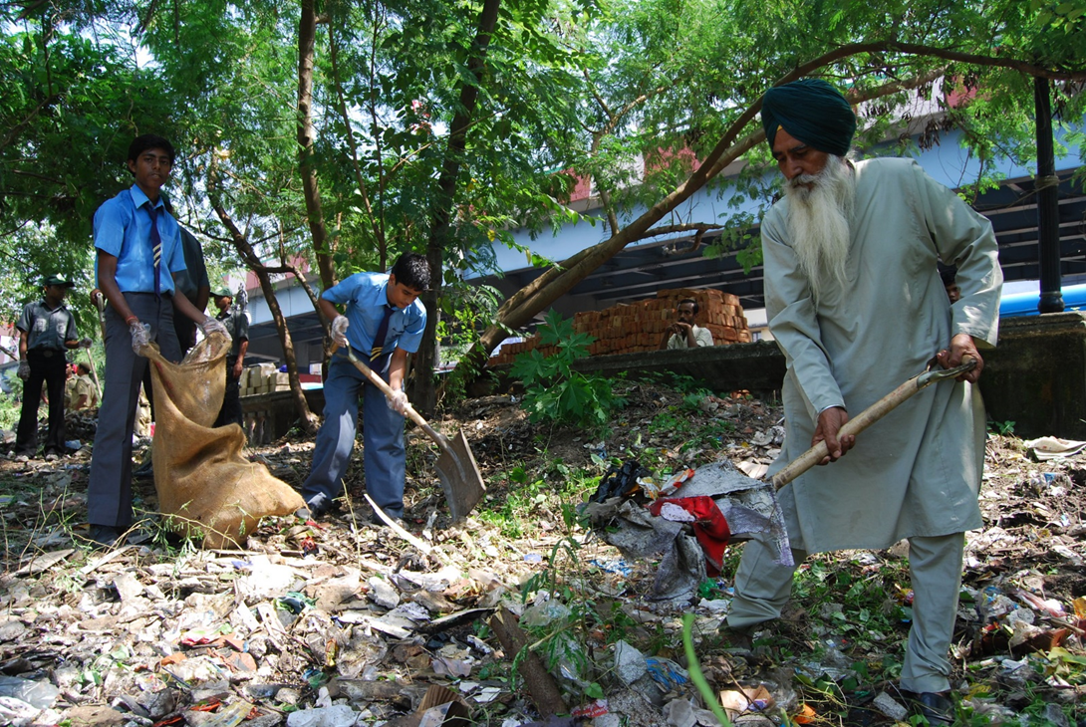
Notes:
EcoSikh

Slide 7
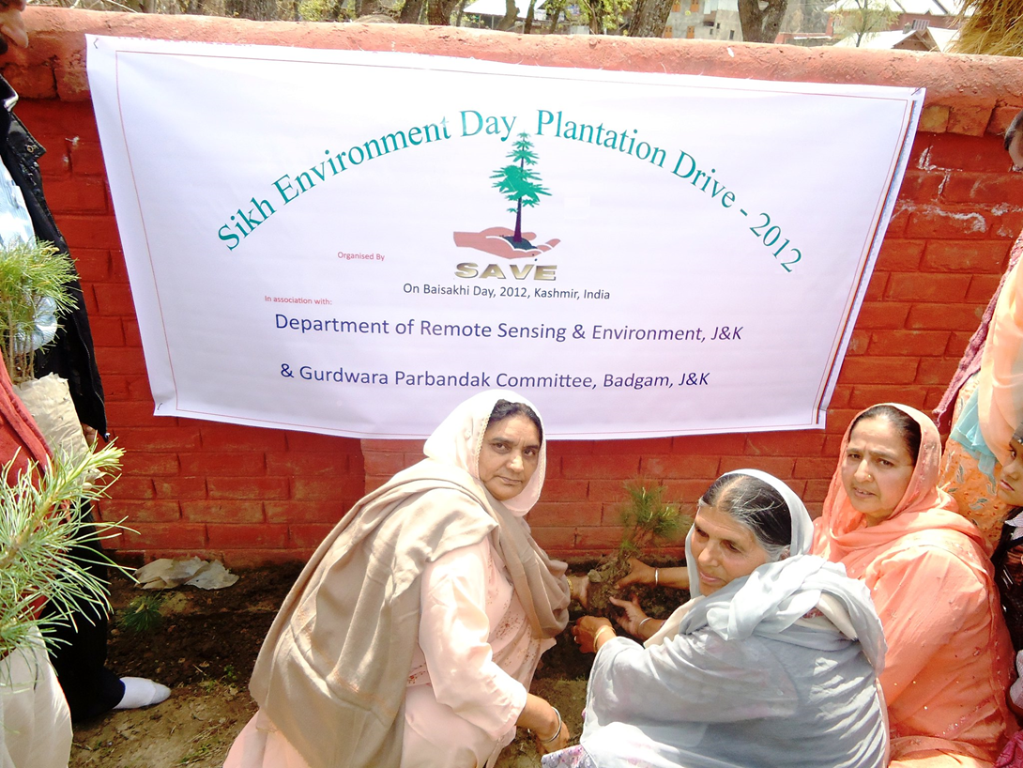
Notes:
EcoSikh

Slide 8
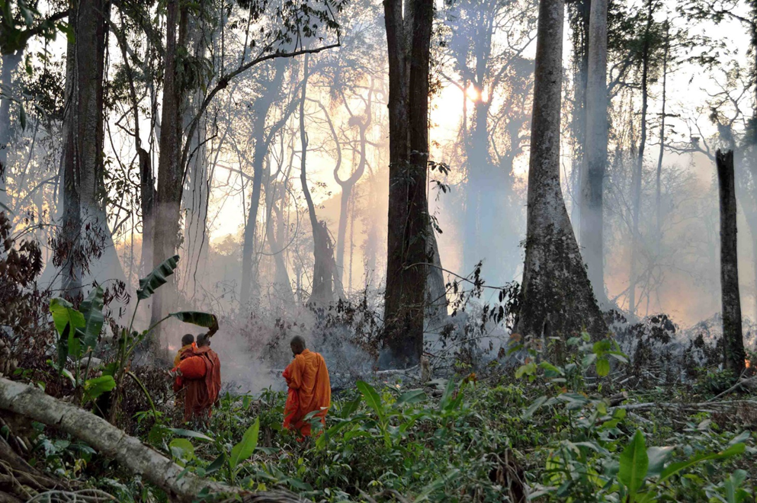
Notes:
Buddhist
Buddhists ordain trees as monks to save forests (faithplans.org)

Slide 9
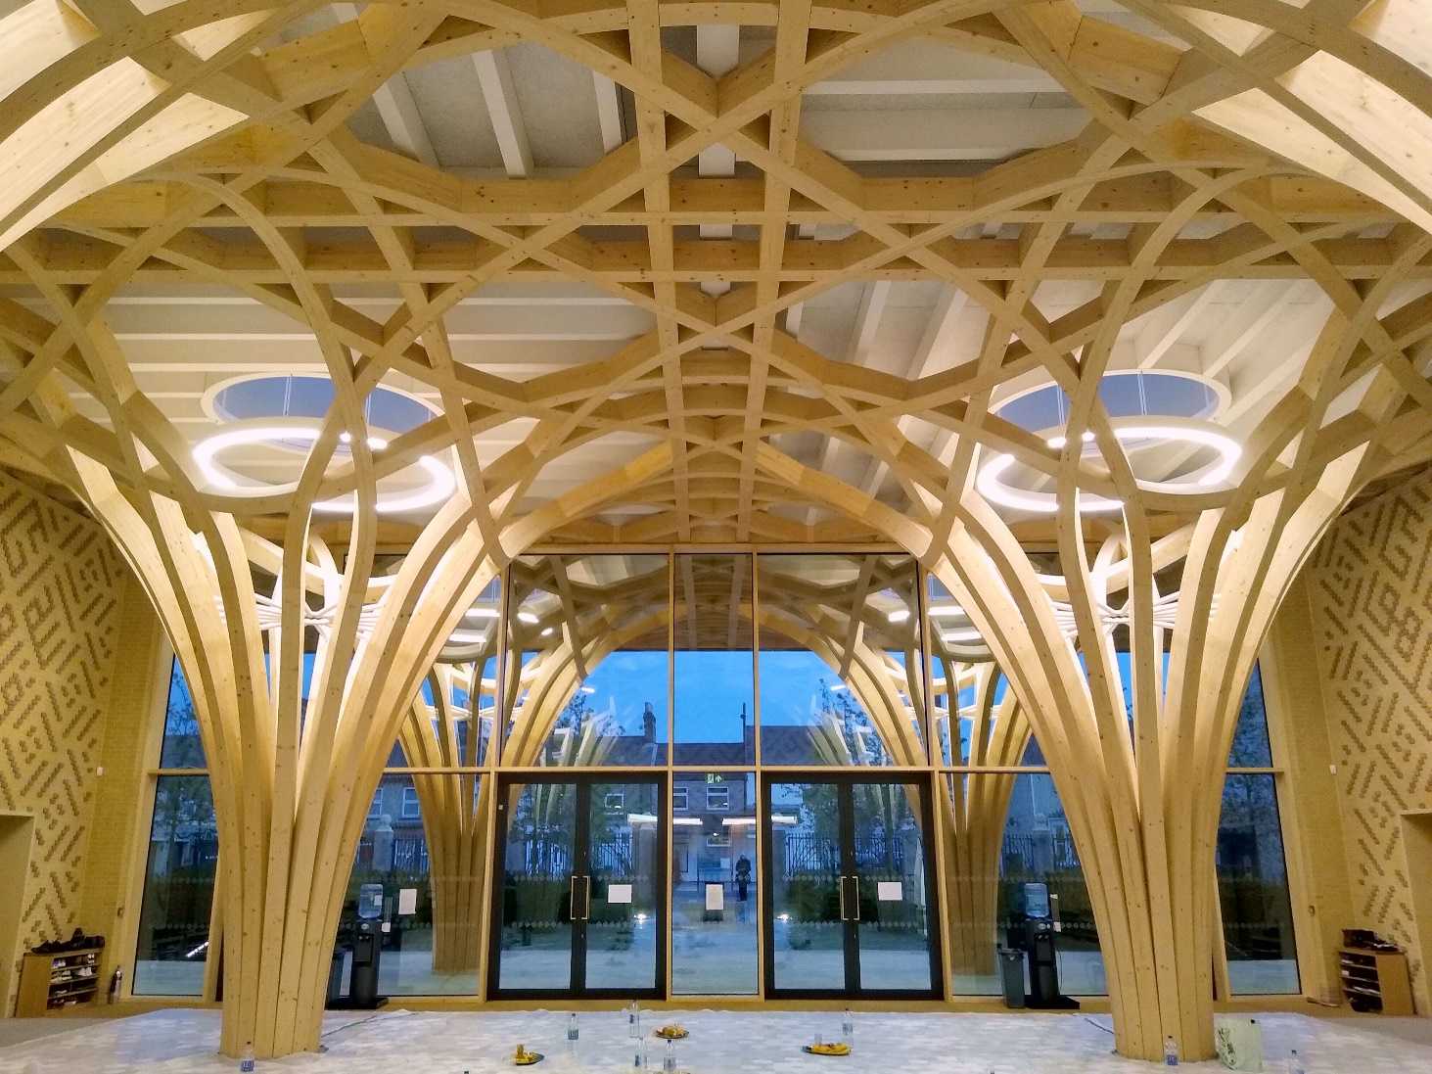
Notes:
Muslim Eco Mosque

Slide 10
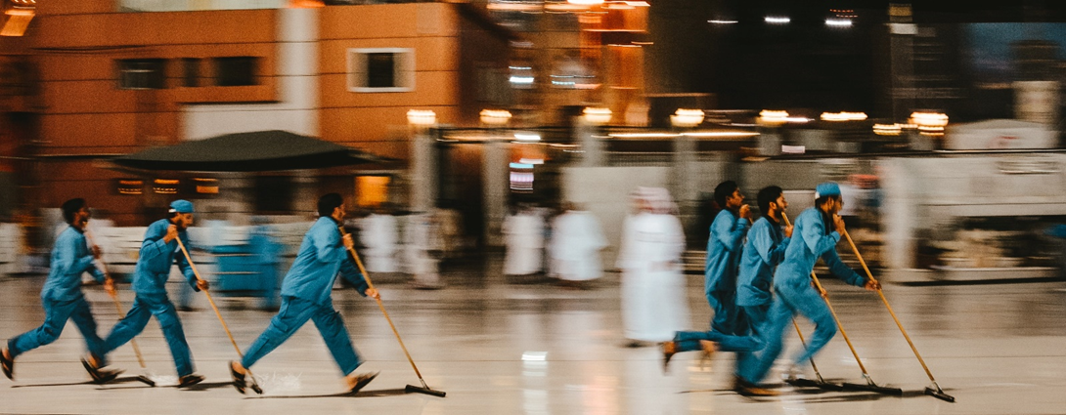
Notes:
Muslim
Green Hajj | Being the guardian of the earth

Slide 11

Notes:
Jewish
West London Synagogue - EcoSynagogue

Slide 12
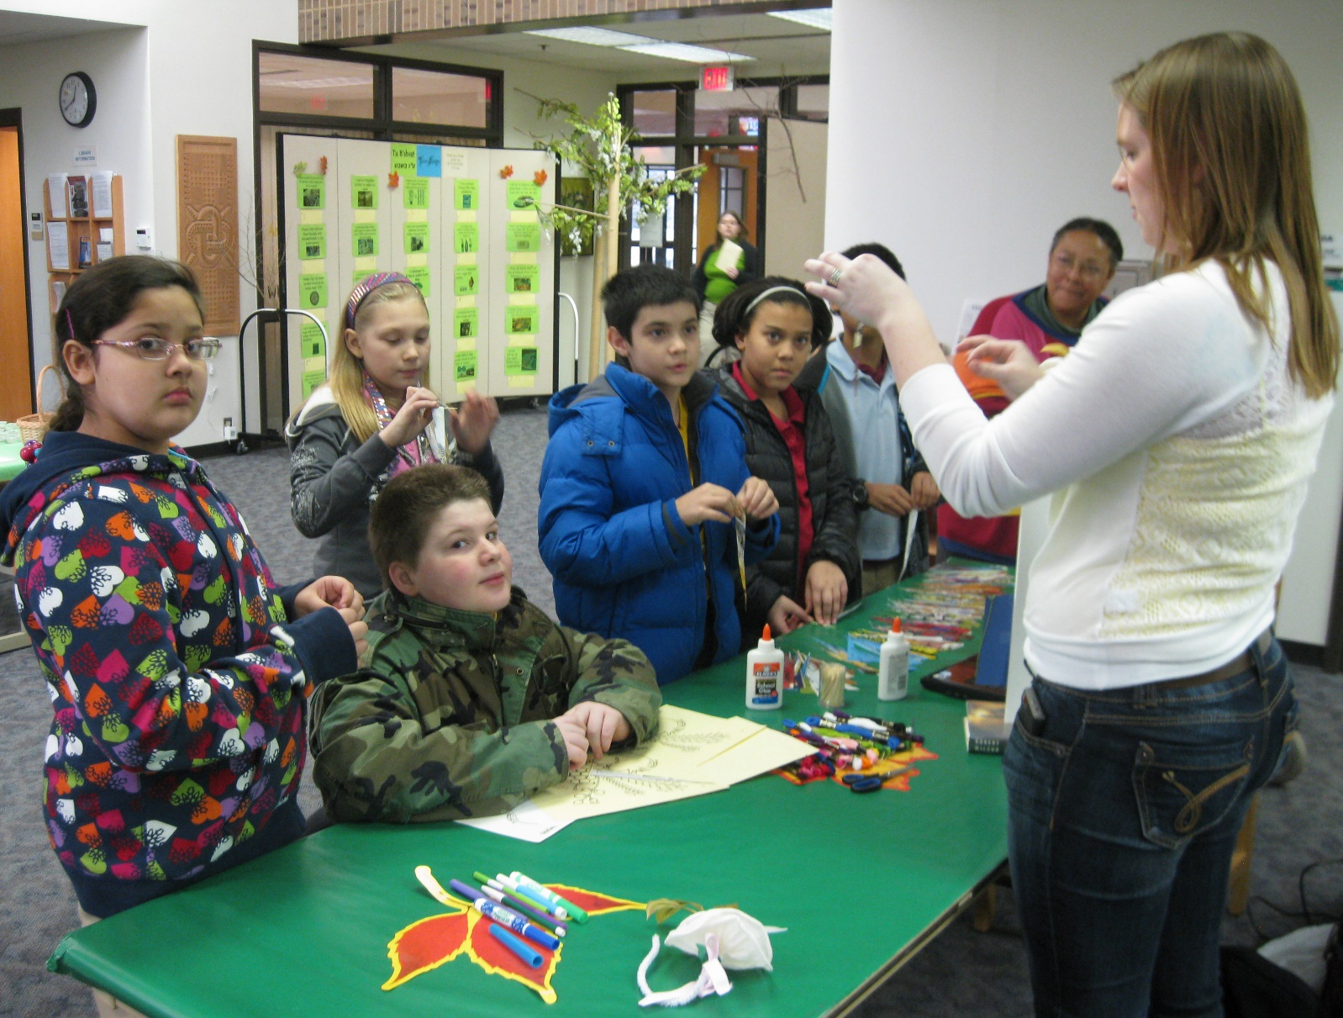
Notes:
Jewish
Tu BiShvat - Wikipedia

Slide 13
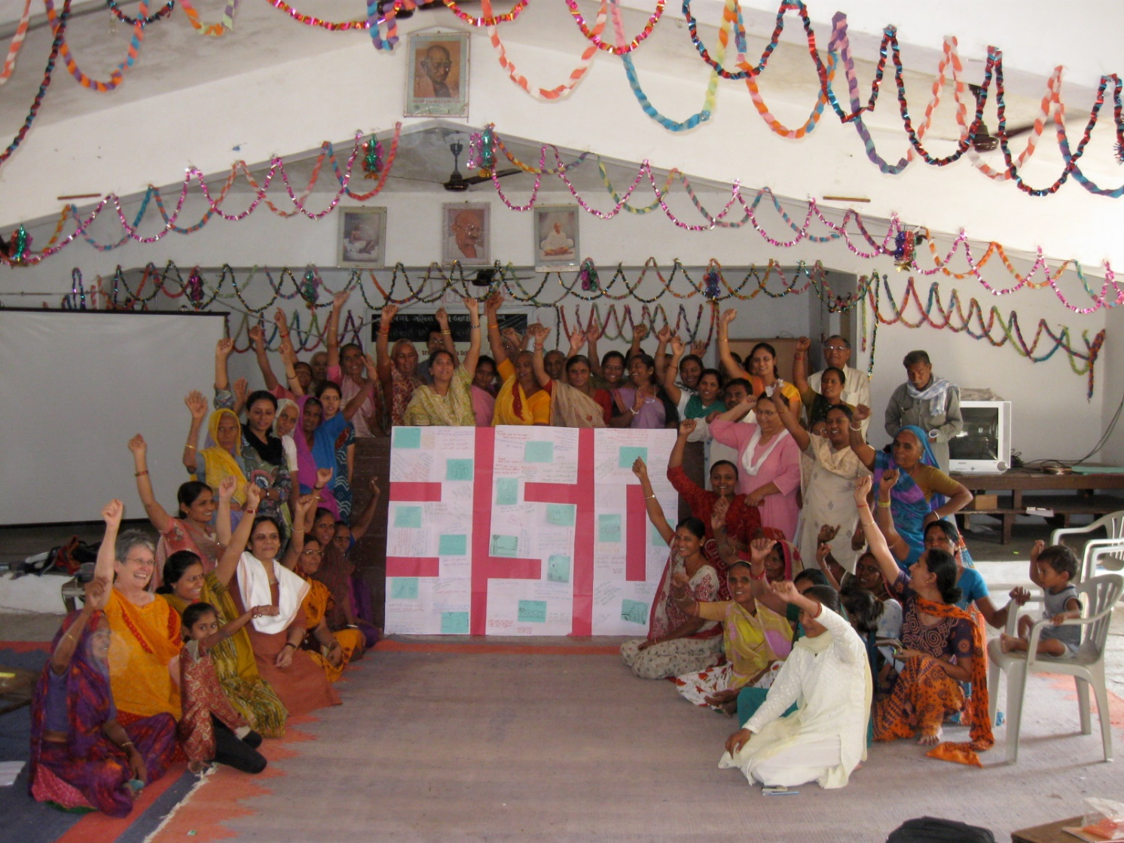
Notes:
Hindu
Women as climate action ambassadors in coastal districts of India’s Odisha State (unep.org)

Slide 14
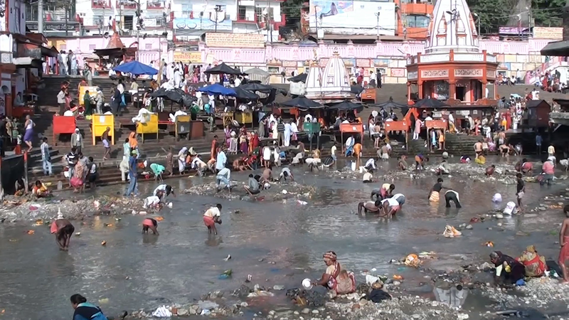
Notes:
Hindu

